Slide 1
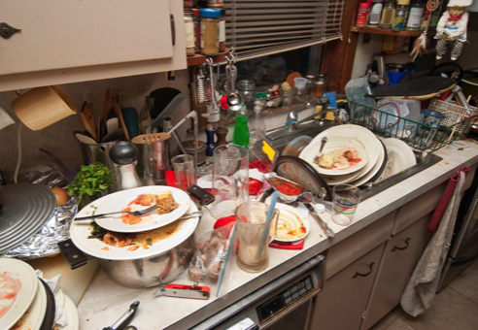
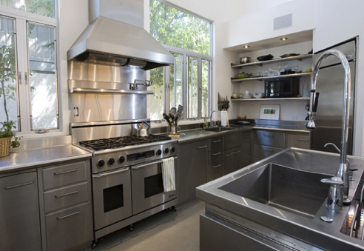
CLEAN CODE

Slide 2
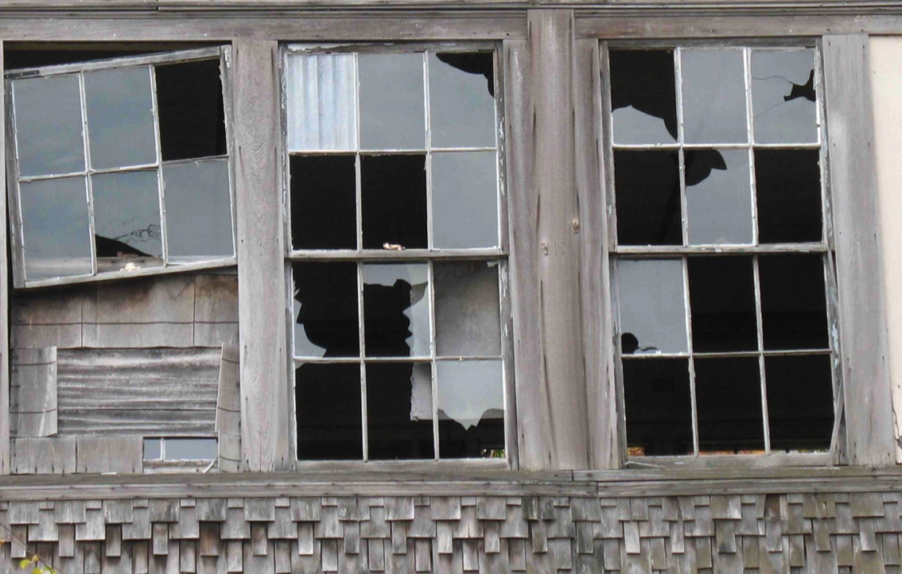
Code rots
Rotten code attracts rotten code

Slide 3

Development is not only about code
Code without tests or review is half an investment

Slide 4
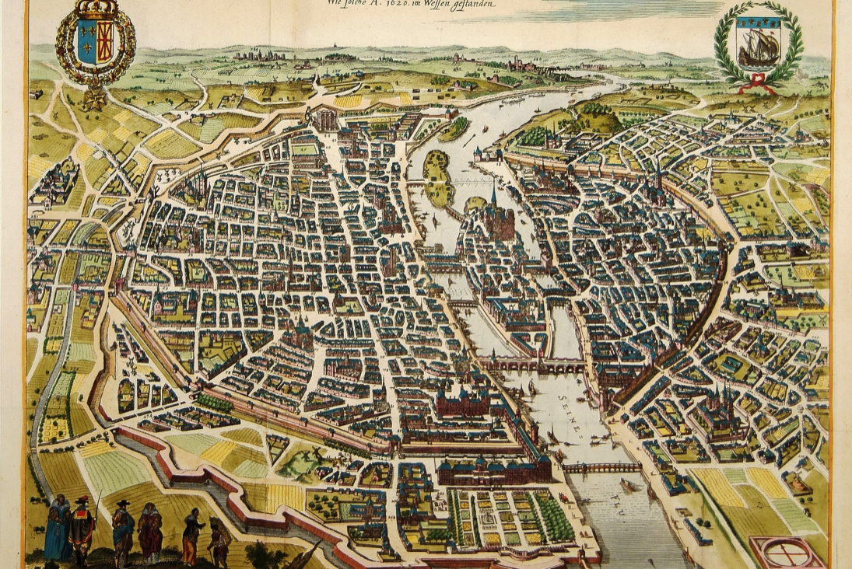
A complex system is not build in a day
Design made in advance becomes obsolete even before coding begins

Slide 5
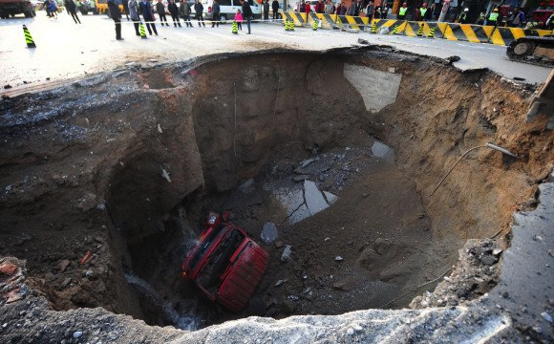
Systematic rebuilds are waste
Rewriting code without testing gives random results

Slide 6
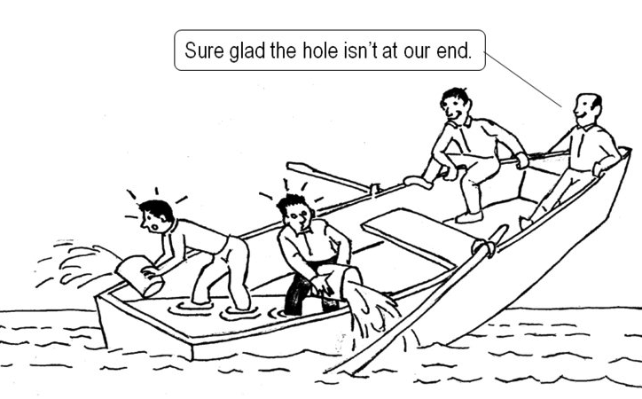
Tests are part of the product
Ergo, tests are also developers responsabilities

Slide 7
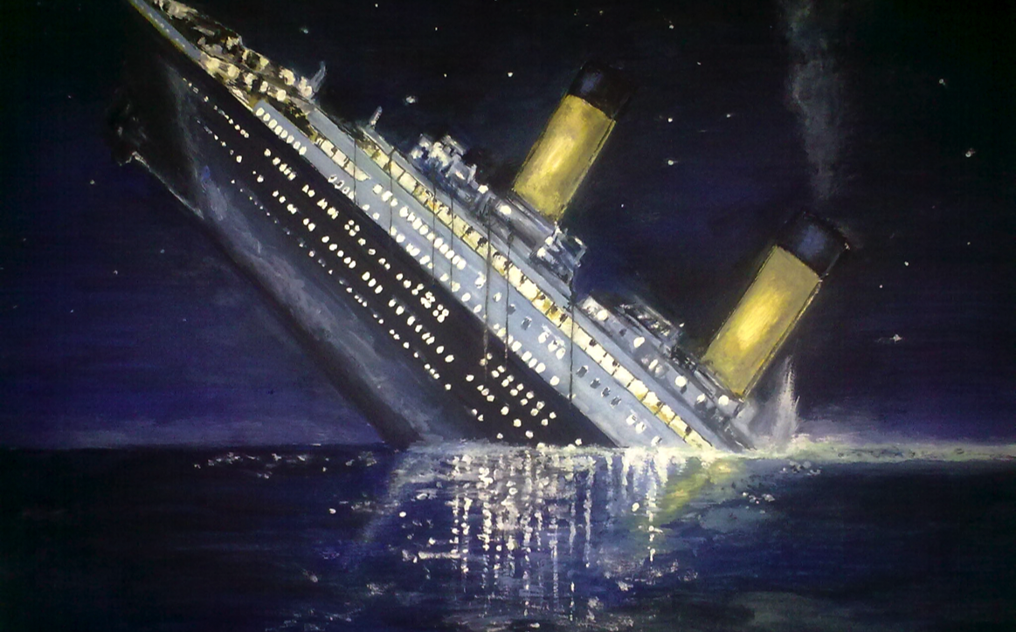
« Failure is impossible » leads to failure
Unused feedback is no feedback at all

Slide 8
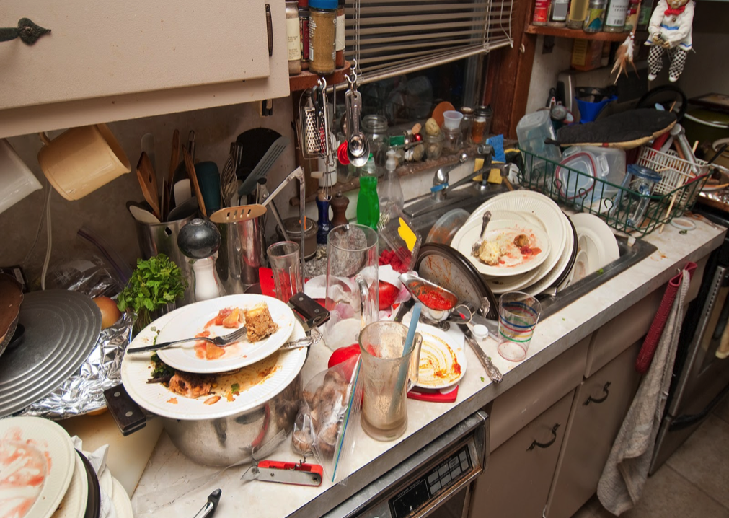
Dirty code slows release of new features
Maintenability must be maintained

Slide 9
Exercise
Find a piece of code you deem interesting
It can be very good code or very bad code
Find the characteristics that make the code that way
Notes:
Par binome. On ne montre pas de code.

Slide 10
Why clean code is important?
There are two ways of constructing a software design: One way is to make it so simple that there are obviously no deficiencies, and the other way is to make it so complicated that there are no obvious deficiencies. The first method is far more difficult.
Hoare

Slide 11
Why clean code is important?
The system technical structure and quality influence the system functional quality.
Devs are living in code
It’s not only a product, it’s also a work environment.
Today’s code quality impacts tomorrow’s code quality
Maintenability must be maintained
Code is the design
Code Quality = Abstractions Quality = Evolutivity
Maintenability = Ease to evolve = Evolutivity

Slide 12
What is Clean code?
TDD code characteristics:
All tests are passing
No duplication
Shows intent
Few classes, methods, etc.

Slide 13
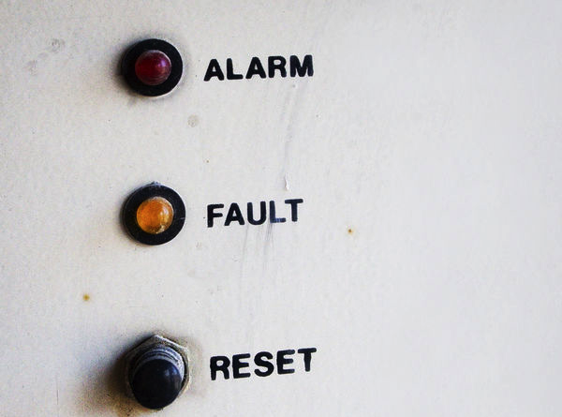
All tests are passing
Notes:
testé = refactorable
Pourquoi refactorer sur barre verte: comment raisonner sur un code qui ne marche pas?

Slide 14
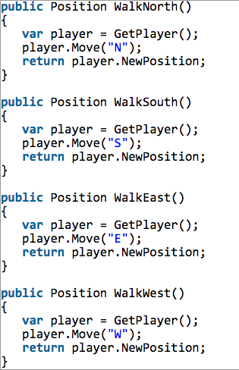
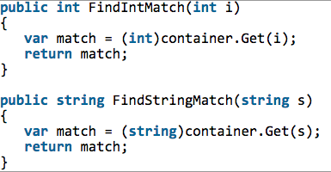
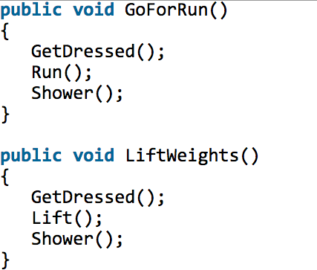
No duplication
Notes:
3 raisons: duplication = perte de temps et d'attention, fix N fois, on croit que c’est la même chose mais en fait non

Slide 15
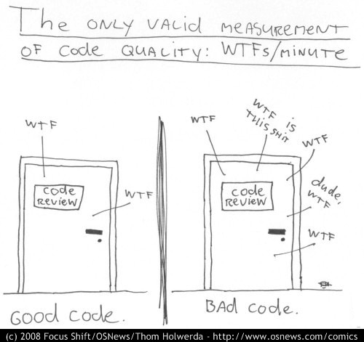
Show Intent
Notes:
principe de moindre surprise
faire attention à ses lecteurs

Slide 16
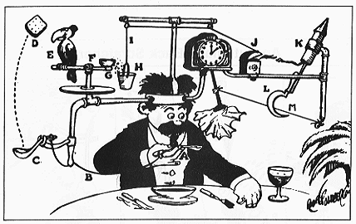
Few Classes, Methods, Lines
Notes:
keep it simple, stupid
you ain't gonna need it

Slide 17
Do
Identify code for a user functionality (ex: Contract Subscription form).
Imagine a change for this functionality (ex: ask more data to the form depending on the value of a specific field )
Find how many change site this would trigger in your code

Slide 18
What practices for Clean code?
Test Driven Development
Refactoring
Code reviews

Slide 19
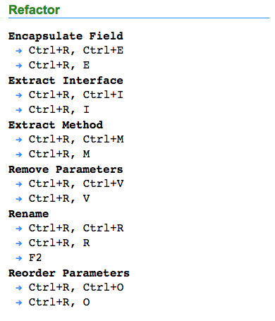
Tools for clean code?
Your IDE!
Refactoring tools
Code quality tools
http://visualstudioshortcuts.com/2013/

Slide 20
Clean Code and Agile: where to start?
Agile
Maintenable
Code
Easy Evolutions
Flexible
Code
Tested Code
Abstractions Quality
Refactor at every step
Test
Driven
Development
Shortcuts, tools
Code review,
Standards

Slide 21

Boy Scout Rule
«Leave this world a little better than you found it»
Baden-Powell
« Leave code better than you found it »
Robert « Uncle Bob » Martin

Slide 22
Exemple d’exercice: Clarté du code
Prenez un moment pour identifier et retrouver sur votre PC un extrait de code (une méthode) que vous trouvez intéressant et de bonne qualité.
Lisez le code à voix haute.
Ecoutez le code lu. Expliquez ce que fait ce code.
Améliorez le code jusqu'à ce que les personnes qui écoutent sachent expliquer ce que fait le code.

Slide 23
Notations
Dans l'S, à une heure d'affluence. Un type dans les vingt-six ans, chapeau mou avec cordon remplaçant le ruban, cou trop long comme si on lui avait tiré dessus. Les gens descendent. Le type en question s'irrite contre un voisin. Il lui reproche de le bousculer chaque fois qu'il passe quelqu'un. Ton pleurnichard qui se veut méchant. Comme il voit une place libre, se précipite dessus.
Deux heures plus tard, je le rencontre cour de Rome, devant la gare Saint- Lazare. Il est avec un camarade qui lui dit : "tu devrais faire mettre un bouton supplémentaire à ton pardessus."; il lui montre où (à l'échancrure) et pourquoi.
Litotes
Nous étions quelques-uns à nous déplacer de conserve. Un jeune homme, qui n'avait pas l'air très intelligent, parla quelques instants avec un monsieur qui se trouvait à côté de lui, puis il alla s'asseoir. Deux heures plus tard, je le rencontrai de nouveau ; il était en compagnie d'un camarade et parlait chiffons.
Surprises
Ce que nous étions serrés sur cette plate-forme d’autobus ! Et ce que ce garçon pouvait avoir l’air bête et ridicule ! Et que fait-il ? Ne le voilà-t-il pas qui se met à vouloir se quereller avec un bonhomme qui – prétendait-il ! ce damoiseau ! – le bousculait ! Et ensuite il ne trouve rien de mieux à faire que d’aller vite occuper une place laissée libre ! Au lieu de la laisser à une dame !
Deux heures après, devinez qui je rencontre devant la gare Saint-Lazare ? Le même godelureau ! En train de se faire donner des conseils vestimentaires ! Par un camarade !
À ne pas croire !
Rétrograde
Tu devrais ajouter un bouton à ton pardessus, lui dit son ami. Je le rencontrai au milieu de la cour de Rome, après l'avoir quitté se précipitant avec avidité vers une place assise. Il venait de protester contre la poussée d'un autre voyageur, qui, disait-il, le bousculait chaque fois qu'il descendait quelqu'un. Ce jeune homme décharné était porteur d'un chapeau ridicule. Cela se passa sur la plate-forme d'un S complet ce midi-là.
Raymond Queneau ~ Exercices de Style

Slide 24
Names
Use names that show intent
Avoid misinformation
Make distinctions that make sense
Use easy to pronounce names
Use easy to find names
Do not codify
Avoid mind mappings
Don’t brag
One word by concept
No play on words
Use names coming from the solution domain
Use names from the problem domain (business)
Add context when it makes sense
Don’t add context for nothing
Notes:
Global Station Deluxe -> GSD

Slide 25
Functions
Short!
Does one thing and does it right
One level of abstraction by function
Readable from top to bottom: Stepdown Rule
Use descriptive names
Few parameters
No 'flags'
No side effect
Query / Command Separation
Prefer exception to error code
Don’t repeat yourself

Slide 26
Comments
Don’t comment bad code : rewrite it
Explain with the code
Good comments:
« legalese »
Informational comments
Intent explanation
Warning on consequences
Amplification
Bad comments
Rant
Redundant
Misleading comments
Mandatory comments
Code history
« Noise »
Scary noise
Comment to open/close a code block
Commented code
Don’t use a comment when you can replace it with a function or a variable

Slide 27
Les principes SOLID
Single Responsibility
Open/Closed
Liskov (substitution principle)
Interface segregation
Dependency Inversion

Slide 28
SOLID
Single Responsibility
It is a computer programming principle that states that every module or class should have responsibility over a single part of the functionality provided by the software, and that responsibility should be entirely encapsulated by the class. All its services should be narrowly aligned with that responsibility. Bob Martin expresses the principle as, "A class should have only one reason to change.”

Slide 29
//SRP bad example
public class Employee{
private String employeeId;
private String name;
private string address;
private Date dateOfJoining;
public boolean isPromotionDueThisYear(){
//promotion logic implementation
}
public Double calcIncomeTaxForCurrentYear(){
//income tax logic implementation
}
//Getters & Setters for all the private attributes
}
//SRP good example
public class HRPromotions{
public boolean isPromotionDue (Employee emp){
//promotion logic implementation using the employee information passed
}
}

Slide 30
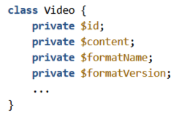
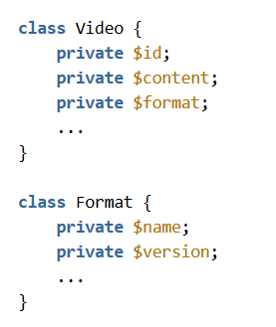

Single Responsability Principle
a class should have only a single responsibility
Wrong
right
class Video {
private $id;
private $content;
private $formatName;
private $formatVersion;
...
}
class Video {
private $id;
private $content;
private $format;
private $format;
...
}
class Format {
private $name;
private $content
}

Slide 31
SOLID
Open/Closed
software entities … should be open for extension, but closed for modification.
A class is closed, since it may be compiled, stored in a library, baselined, and used by client classes.
But it is also open, since any new class may use it as parent, adding new features. When a descendant class is defined, there is no need to change the original or to disturb its clients.^{[4]}

Slide 32
Open
Open-Close Principle
// Open-Close Principle - Bad example class GraphicEditor { public void drawShape(Shape s) { if (s.m_type==1) drawRectangle(s); else if (s.m_type==2) drawCircle(s); } public void drawCircle(Circle r) {....} public void drawRectangle(Rectangle r) {....} } class Shape { int m_type; } class Rectangle extends Shape { Rectangle() { super.m_type=1; } } class Circle extends Shape { Circle() { super.m_type=2; } }
// Open-Close Principle - Good example class GraphicEditor { public void drawShape(Shape s) { s.draw(); } } class Shape { abstract void draw(); } class Rectangle extends Shape { public void draw() { // draw the rectangle } }

Slide 33
SOLID
Liskov (substitution principle)
objects in a program should be replaceable with instances of their subtypes without altering the correctness of that program.
More formally, the Liskov substitution principle (LSP) is a particular definition of a subtyping relation, called (strong) behavioral subtyping, that was initially introduced by Barbara Liskov in a 1987 conference keynote address titled Data abstraction and hierarchy. It is a semantic rather than merely syntactic relation because it intends to guarantee semantic interoperability of types in a hierarchy, object types in particular. Barbara Liskov and Jeannette Wing formulated the principle succinctly in a 1994 paper as follows:
Subtype Requirement:
Let ϕ ( x ) be a property provable about objects x of type T.
Then ϕ ( y ) should be true for objects y of type S where S is a subtype of T.

Slide 34
public class Rectangle {
private int length;
private int breadth;
public int getArea() {
return this.length * this.breadth;
}
}
public class Square extends Rectangle{
@Override
public int getArea() {
return this.length * this.length;
}
}
public class Square extends Rectangle {
@Override public void setBreadth(int breadth) {
super.setBreadth(breadth);
super.setLength(breadth);
}
@Override public void setLength(int length) {
super.setLength(length);
super.setBreadth(length);
}
}

Slide 35
SOLID
Interface segregation
many client-specific interfaces are better than one general-purpose interface
The interface-segregation principle (ISP) states that no client should be forced to depend on methods it does not use ISP splits interfaces that are very large into smaller and more specific ones so that clients will only have to know about the methods that are of interest to them. Such shrunken interfaces are also called role interfaces. ISP is intended to keep a system decoupled and thus easier to refactor, change, and redeploy.

Slide 36
SOLID
Single Responsibility
a class should have only a single responsibility
Open/Closed
software entities … should be open for extension, but closed for modification.
Liskov (substitution principle)
objects in a program should be replaceable with instances of their subtypes without altering the correctness of that program.
Interface segregation
many client-specific interfaces are better than one general-purpose interface
Dependency Inversion
one should “Depend upon Abstractions. Do not depend upon concretions

Slide 37
Law of Demeter
a method m of an object O may only invoke the methods of the following kinds of objects
O itself
m's parameters
Any objects created/instantiated within m
O's direct component objects
A global variable, accessible by O, in the scope of m
Use one dot only

Slide 38
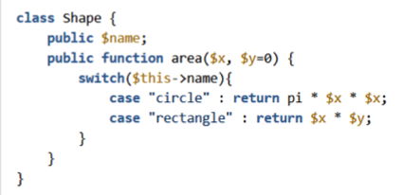
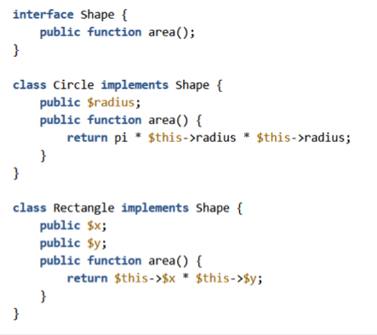
Open/Closed Principle
software entities … should be open for extension, but closed for modification
WRONG
RIGHT
}
}

Slide 39
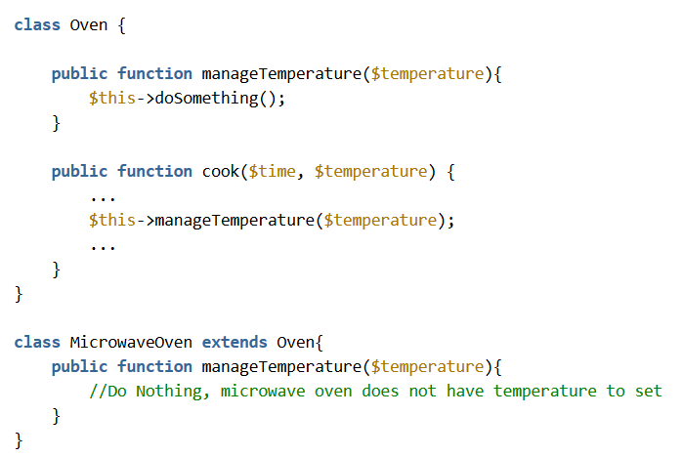
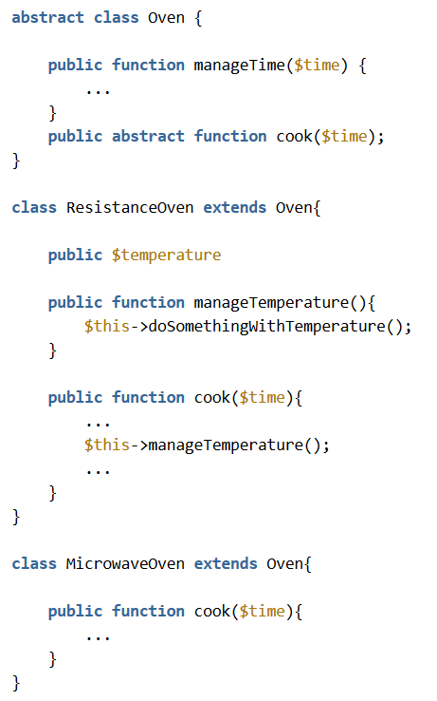
Liskov Substitution Principle
objects in a program should be replaceable with instances of their subtypes without altering the correctness of that program
WRONG
RIGHT

Slide 40
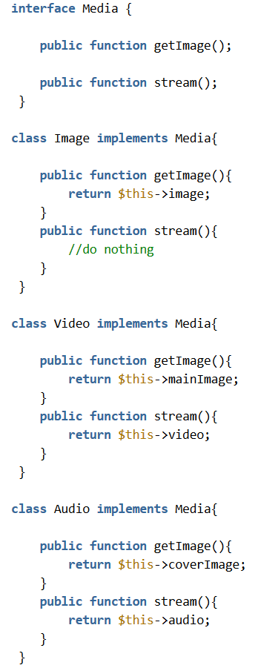
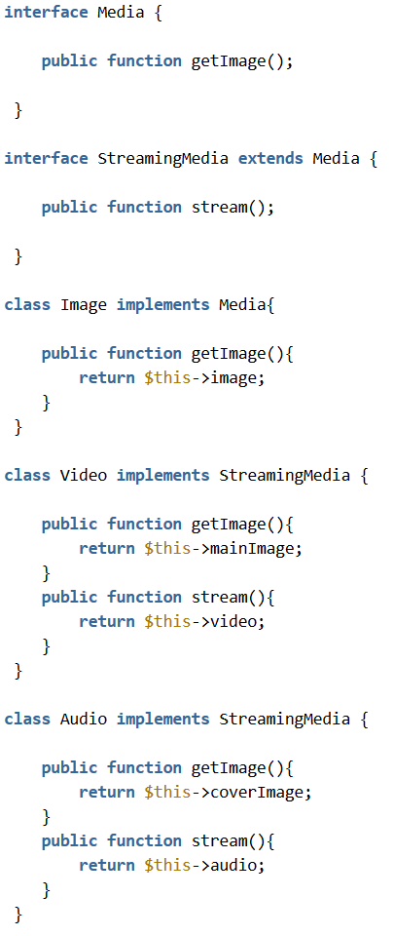
Interface Segregation Principle
many client-specific interfaces are better than one general-purpose interface
WRONG
RIGHT

Slide 41
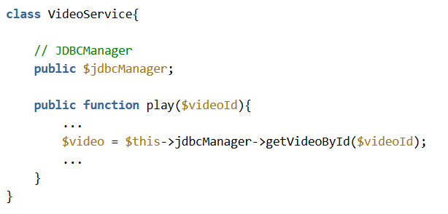
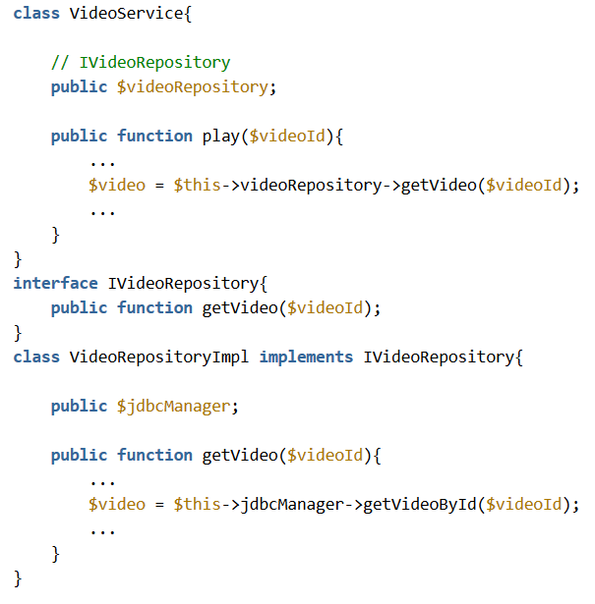
Dependency Inversion Principle
one should “Depend upon Abstractions. Do not depend upon concretions
WRONG
RIGHT

Slide 42
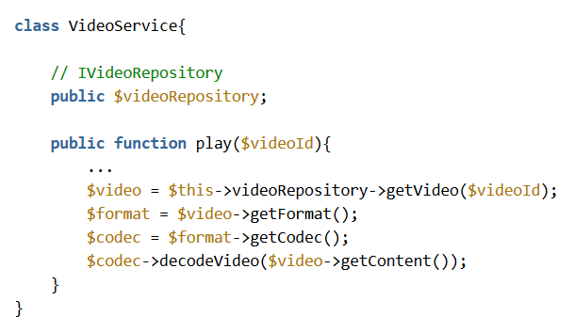
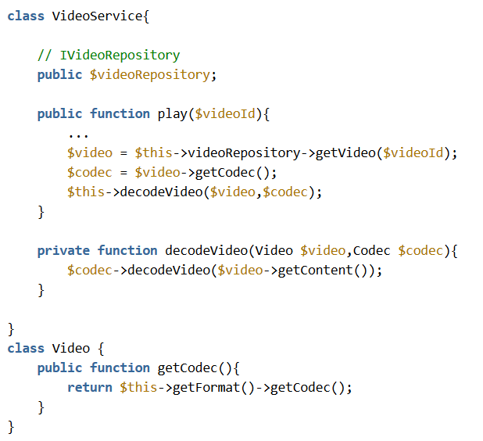
Law of Demeter
a method m of an object O may only invoke the methods of the following kinds of objects
O itself
m's parameters
Any objects created/instantiated within m
O's direct component objects
A global variable, accessible by O, in the scope of m
WRONG
RIGHT

Slide 43
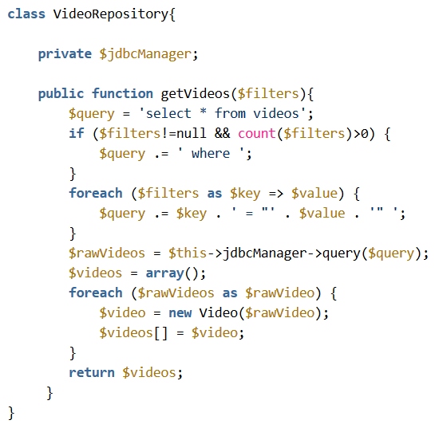
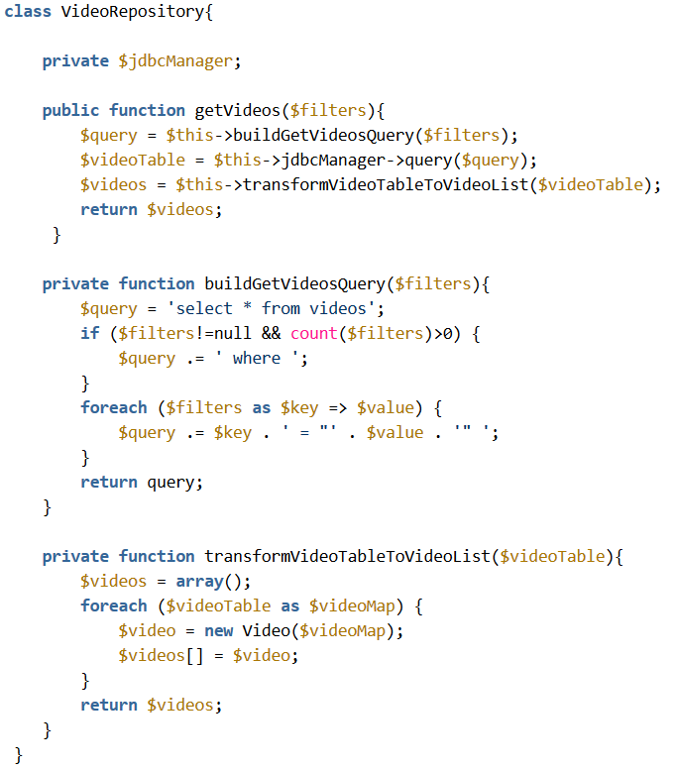
Level of abstraction (Step Down Rule)
In a method, all element must share the same level of abstraction
WRONG
RIGHT

Slide 44


